Slide 1

AI Advantages
GLOBAL AI EXPERTISE · LOCALLY DELIVERED
E M P O W E R I N G
10,000+
Saudi Arabia's
AI Leaders
Senior Executives Trained
120+
Years Combined AI Experience
In Partnership with Absolute Solutions Riyadh – Local Saudi Partner
Fortune 500
Executive AI Education
for Government & Enterprise
BofA · JPMorgan · Morgan Stanley · Barclays
Ivy League
MIT · Harvard · Kellogg · Columbia
✦ Vision 2030 Aligned
SDAIA Partner Ready
www.aiadvantages.ai · rehan@aiadvantages.ai · +1 908-300-6745 · 5 Cowboys Way, Suite 300, Frisco, Texas local partner Absolute Solutions

Slide 2
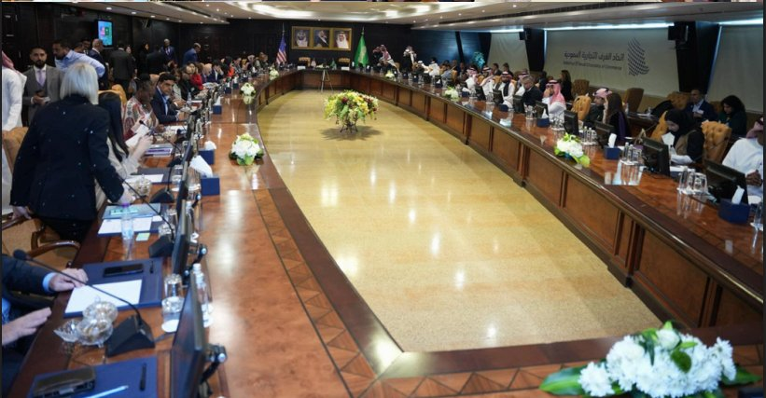
IN THE ROOM — SAUDI-US CHAMBER OF COMMERCE
Proven Access.
Established Saudi Relationships.
✦ Saudi-US Chamber of Commerce
Participated in bilateral AI & trade working sessions in-Kingdom
✦ US Embassy Riyadh
AI Working Group · US Dept. of Commerce Technology Showcase
✦ KSA Government & Enterprise
Active engagements with public sector and Fortune 500 clients in-Kingdom
✦ Arabic Delivery Available
All programs localized for KSA — Arabic delivery on request
www.aiadvantages.ai · rehan@aiadvantages.ai · +1 908-300-6745 · 5 Cowboys Way, Suite 300, Frisco, Texas local partner Absolute Solutions

Slide 3
WHY AI ADVANTAGES
Your Trusted AI Partner for Saudi Arabia
Delivered locally in Saudi Arabia through our official partner: Absolute Solutions
10,000+
120+
Fortune 500
Ivy League
Senior Executives
Trained Globally
Years Combined AI
Experience & 30+ Experts
BofA · JPMorgan · Barclays
Morgan Stanley · Pfizer
MIT · Harvard · Kellogg
Georgia Tech · Columbia
Our Mission
We create customized executive AI education programs grounded in cutting-edge academic research and real-world deployments across 420+ AI systems. Programs are data-driven, practice-based, and tailored to the regulatory, strategic, and operational needs of government and enterprise organizations in the Kingdom of Saudi Arabia.
$1.8B Enterprise Value Delivered · 420+ AI Systems · Zero Regulatory Findings across Fed, OCC & NCUA
✦ Saudi Arabia & Vision 2030
Our programs align directly with SDAIA mandates, the National AI Strategy, and KSA's ambition to lead global AI by 2030. Available in Arabic. Customized for government agency contexts.
www.aiadvantages.ai · rehan@aiadvantages.ai · +1 908-300-6745 · 5 Cowboys Way, Suite 300, Frisco, Texas Local partner Absolute Solutions

Slide 4
THE BURNING PLATFORM — WHY NOW
Saudi Arabia Has Committed $40B to AI.
The Leaders Who Act Now Will Define the Decade.
$40B
Saudi AI Investment Committed
SDAIA is executing the National AI Strategy at pace. Government agencies have mandatory AI readiness targets by 2026.
74%
of AI Initiatives Fail to Scale
Without leadership capability and governance architecture, investment does not translate to outcomes. — BCG
5+
Giga-Projects Demanding AI Leadership
NEOM, Red Sea, Qiddiya, ROSHN, Diriyah. Each requires AI-literate executives and sovereign governance capacity.
2030
The Window Is Fixed. The Clock Is Running.
Organizations that build AI leadership capability now will lead. Those that wait will procure from those who did.
www.aiadvantages.ai · rehan@aiadvantages.ai · +1 908-300-6745 · 5 Cowboys Way, Suite 300, Frisco, Texas Local partner Absolute Solutions

Slide 5
EXECUTIVE PROGRAMS — 2026
AI Education for Every Leadership Level
STRATEGY
C-SUITE
AI Strategy & Innovation
C-Suite Executive Leadership
— AI Impact Assessment & Readiness
— Chief AI Officer (CAIO) Program
— AI Strategy Development
— Chief Data & AI Officer (CDAIO)
— Agentic AI Transformation Roadmap
— AI Governance & Responsible AI
— Data Strategy & Governance Framework
— ISO 42001 Certification Track
In-Person · Remote · 1–3 Day Workshop
In-Person · Remote · 2–3 Day Workshop
GOVERNANCE
TECHNICAL
AI Governance & Responsible AI
Technical Leadership
— Vision 2030 AI Governance Track
— Mastering Generative AI & LLMs
— Agentic AI Risk & Oversight
— Agentic AI Systems & Workflows
— ISO 42001 & ISO 27001 Alignment
— AI Product Management
— SDAIA & National AI Strategy Alignment
— AI Ethics & Societal Trust
— Building & Deploying Scalable AI Products
In-Person · Remote · Virtual
In-Person · Remote · Virtual
CERTIFICATION | ISO 42001 & ISO 27001 Lead Auditor · AI Management Systems · Integrated Audit Readiness · KSA-aligned
www.aiadvantages.ai · rehan@aiadvantages.ai · +1 908-300-6745 · 5 Cowboys Way, Suite 300, Frisco, Texas

Slide 6
INVESTMENT PACKAGES — KSA 2026
Choose the Right Engagement Model
Executive Workshop
1–3 Days · C-Suite · In-Person or Remote
✓ AI Strategy for Leaders
✓ Agentic AI Briefing
✓ Vision 2030 Alignment
✓ Arabic Available
From $15,000
per cohort
AI Readiness Assessment
Standalone · 2–4 Weeks
✓ 220+ Maturity Indicators
✓ 8 Dimensions Scored
✓ KSA Peer Benchmarking
✓ SDAIA-Framework Aligned
From $25,000
per organization
★ BESPOKE ★
All-in KSA Program
Custom · End-to-End
Everything included:
✓ AI Readiness Assessment
✓ AI Strategy Development
✓ Executive + Staff Training
✓ ISO 42001 Certification
✓ Ongoing Retainer
✓ Arabic + In-Kingdom Delivery
──────────────────────
Custom Investment
Contact us to scope your program
Certification Program
ISO 42001 · CAIO Track · 3–6 Months
✓ ISO 42001 Lead Auditor Prep
✓ CAIO Executive Credential
✓ AI Governance Frameworks
✓ SDAIA Regulation Aligned
From $35,000
per cohort
Enterprise Retainer
Ongoing Advisory · 12 Months
✓ Dedicated AI Advisory
✓ Quarterly Executive Workshops
✓ AI Governance Reviews
✓ Priority In-Kingdom Access
From $120,000
per year
All packages include Arabic delivery · In-Kingdom availability · SDAIA-aligned content · Customized for your organization
www.aiadvantages.ai · rehan@aiadvantages.ai · +1 908-300-6745 · 5 Cowboys Way, Suite 300, Frisco, Texas local partner Absolute Solutions

Slide 7
AI READINESS ASSESSMENT
Know Where You Stand.
Before You Invest.
01
02
03
04
05
◉
◎
◈
◆
✦
ASSESS
DIAGNOSE
BENCHMARK
ROADMAP
DELIVER
Current State
▶
Gap Analysis
▶
KSA Peer Compare
▶
Prioritize Paths
▶
AI Readiness Report
Framework & Approach
Culture & Leadership
Metrics & KPIs
Organization & Skills
Architecture & Integration
Governance & Quality
Data Readiness
Technology & Operations
220+ indicators
Customized for your org
DELIVERABLE: Comprehensive AI Readiness Report — gap analysis, benchmark comparisons against KSA sector peers, target maturity levels per dimension, and a prioritized implementation roadmap. Customized for your organization.
220+
Maturity Indicators
8
Critical Dimensions Scored
4–6 Weeks
Engagement to Report
www.aiadvantages.ai · rehan@aiadvantages.ai · +1 908-300-6745 · 5 Cowboys Way, Suite 300, Frisco, Texas local partner Absolute solutions

Slide 8





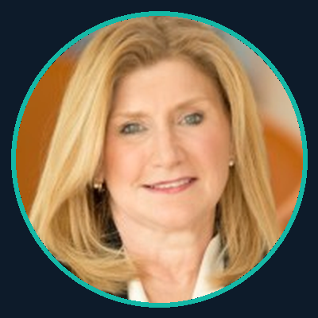






FACULTY
American & Ivy League Faculty
MIT · Harvard · Kellogg · Columbia · Georgia Tech · Stanford · Carnegie Mellon
Rehan Kausar
Denise
Dr. Michael G.
Dr. Jon Pangia — USA
CAIO & Lead Faculty
CDO - AI Strategy
ML & Data Science
AI Governance
Northwestern Kellogg
Carnegie Mellon
Georgia Tech · Stanford
Kellogg · Johns Hopkins
Kimberley C.
Ali K.
JoAnn S.
Doug L.
Generative AI
Data Strategy & Governance
Data & AI
Data and Analytics
Specialty AI Institute
The London School of
Economics (LSE)
Carnegie Mellon
MIT · Carnegie Mellon
Dinah R.— Germany
Maero O. – USA/SA
Nil L.
Florence V.
AI Compliance
AI & Innovation
AI Strategy
AI Products & Data
Columbia University
MIT
Northwestern Kellogg
University of Phoenix
www.aiadvantages.ai · rehan@aiadvantages.ai · +1 908-300-6745 · 5 Cowboys Way, Suite 300, Frisco, Texas local partner Absolute solutions

Slide 9
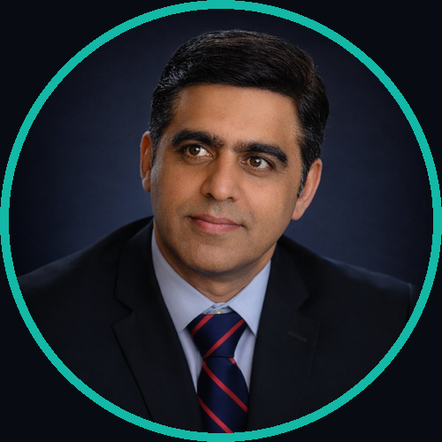

GET STARTED
Partner with AI Advantages
And Absolute Solutions
for Saudi Arabia
CONTACT US
Rehan Kausar
HOW WE ENGAGE
Chief AI Officer & CEO, AI Advantages LLC
✉
rehan@aiadvantages.ai
01
Discovery Session
⊕
www.aiadvantages.ai
Complimentary 2-hour session to understand your organization's AI priorities and learning objectives
☎
+1 908-300-6745 (US)
◎
5 Cowboys Way, Suite 300, Frisco TX 75034
02
Custom Program Design
in
linkedin.com/in/rehankausar
Our faculty collaborates to build a program tailored to KSA's strategic AI mandates
Local Saudi Partner Absolute Solutions
03
Delivery
Faisal Bashir Mughal , COO
Live online, on-demand, or in-person — in English or Arabic
✉
salesksa@ab-sol.net
⊕
www.ab-sol.net | www.ab-sol.com| www.raptoreye.net
04
Continuous Improvement
☎
+966 508 250 090
Ongoing evaluation, cohort reporting, and program refinement for maximum impact
◎
Riyadh Headquarters King Abdullah Road – Exit 10 P.O. Box 7021, Code 12482 Saudi Arabia
Schedule your complimentary 1-hour discovery session today.
AI Advantages: Simplifying AI, Securing Great Results.

Slide 10
C - S U I T E · S I G N A T U R E P R O G R A M
Chief Artificial Intelligence Officer (CAIO)
Same curriculum depth as CMU & Chicago Booth — delivered in a weekend intensive, not 6 months.
CURRICULUM — 8 MODULES
FACULTY
01 AI Foundations & Business Value
Demystifying AI · Enterprise landscape · Value creation
02 AI Strategy & Transformation Roadmap
Business to AI strategy · Use case prioritization · ROI
03 Structuring the CAIO Organization
Operating model · RACI · Team design · Talent
04 Generative AI & LLMs in the Enterprise
GenAI applications · Prompt engineering · Deployment
05 Leading Agentic AI
Agent architectures · Oversight · Human-in-the-loop
06 AI Governance, Risk & ISO 42001
Governance frameworks · Policy · Regulatory alignment
07 AI Cybersecurity & Data Privacy
AI risk · Data protection · Security by design
08 Leading AI in the C-Suite
Board communication · Change leadership · AI culture
MIT · Harvard · Kellogg · Carnegie Mellon · Johns Hopkins · Columbia · US Air Force
2026 DATES — Weekend Intensives
Fri–Sun format · No work days missed
June 20–22 · Dallas, Texas
August 21–23 · Washington, DC
October 9–11 · Miami, FL
December 4–6 · Chicago, IL
FORMAT
Weekend intensive (Fri–Sun) · Live online · Private cohort · Arabic on request
INVESTMENT
From $3,500 per person
From $35,000 private cohort
CERTIFICATION
CAIO Executive Credential · ISO 42001 module included
WHO SHOULD ATTEND?
C-suite & aspiring CAIOs · Risk & compliance leaders · Government agency heads · Regulated industry executives
www.aiadvantages.ai · rehan@aiadvantages.ai · +1 908-300-6745 · 5 Cowboys Way, Suite 300, Frisco, Texas local partner Absolute solutions

Slide 11
C E R T I F I C A T I O N · G O L D S T A N D A R D
ISO 42001 AI Management Systems
Lead Auditor Certification & Enterprise Implementation
The only globally recognized standard for AI management. The only trainer who has lived it across five Fortune 500 institutions — with zero regulatory findings.
WHO SHOULD ATTEND?
WHY THIS MATTERS NOW
Chief AI Officers and Chief Data Officers
AI governance and compliance leaders
Risk, audit, and legal officers responsible for AI oversight
Internal auditors expanding into AI systems
Government agency compliance teams
84% of companies face regulatory pressure on AI — Gartner
ISO 42001 is the baseline requirement in regulated industries
SDAIA driving ISO alignment across all KSA government agencies
US Fortune 500 boards now demanding certified AI governance
WHAT YOU WILL LEARN
FACULTY
Full ISO 42001 framework — structure, requirements, implementation
ISO 42001 conformity assessment and gap analysis
Designing and documenting an AI Management System (AIMS)
Integrating ISO 42001 with ISO 27001 for unified governance
Preparing for third-party certification audit
Applying the standard to Generative AI and Agentic AI deployments
Alignment with SDAIA, SAMA, OCC, and global AI regulatory frameworks
Dual-certified ISO 42001 & ISO 27001 Lead Auditors with active enterprise deployment experience across BofA, Morgan Stanley, Barclays, Citigroup, and HVCU.
FORMAT
3-day intensive · In-person or live online · Arabic available
INVESTMENT
From $3,500 per person · From $30,000 private cohort
CERTIFICATION
ISO 42001 Lead Auditor Preparation Certificate · Exam guidance included
www.aiadvantages.ai · rehan@aiadvantages.ai · +1 908-300-6745 · 5 Cowboys Way, Suite 300, Frisco, Texas local partner Absolute solutions

Slide 12
G O V E R N A N C E · A G E N T I C A I · R E S P O N S I B L E A I
AI Governance & Agentic AI Leadership
From policy frameworks to autonomous agents — govern what you deploy.
AI agents are making decisions and executing tasks without human approval. Most organizations have no governance architecture for this. We build it with you.
WHO SHOULD ATTEND?
AGENTIC AI MODULE
Executives overseeing AI deployment in regulated environments
Risk, compliance, and audit leaders
Technology leaders deploying or evaluating agentic AI
Board members with AI oversight accountability
What is Agentic AI — architectures, capabilities, and risks
Multi-agent systems — orchestration, tool use, and autonomy levels
Human-in-the-loop design — when to intervene and how
Monitoring frameworks for autonomous AI systems
Deploying Agentic AI safely in regulated industries
AI GOVERNANCE MODULE
Building enterprise AI governance frameworks from scratch
RACI models for AI accountability — who owns what
Regulatory alignment — SDAIA, SAMA, OCC, Fed, EU AI Act
Board reporting on AI risk — what directors need to know
ISO 42001 governance integration
FORMAT
2-day executive workshop · In-person or live online · Arabic available
INVESTMENT
From $2,500 per person · From $20,000 private cohort
FACULTY
MIT · Kellogg · Johns Hopkins · Columbia · US Air Force
CERTIFICATION
AI Governance & Agentic AI Certificate of Completion
www.aiadvantages.ai · rehan@aiadvantages.ai · +1 908-300-6745 · 5 Cowboys Way, Suite 300, Frisco, Texas local partner Absolute solutions

Slide 13
W O R K S H O P P R O G R A M S — 2 0 2 6
Hands-On AI Workshops
Available as private corporate engagements or open enrollment · In-person · Online · Hybrid
AI Governance Bootcamp
Build Your Framework in 2 Days
AI governance framework
RACI model & policy templates
Fed, OCC, SDAIA, SAMA alignment
ISO 42001 overview
From $2,500
per person
From $20,000
private cohort
ISO 42001 Intensive
Get Audit-Ready in 3 Days
Full ISO 42001 framework
Gap analysis & AIMS documentation
ISO 27001 integration module
Audit preparation roadmap
From $3,500
per person
From $30,000
private cohort
Agentic AI for Leaders
Deploy Agents Without Losing Control
Agentic AI risk taxonomy
Human-in-the-loop design
Governance for AI agents
Monitoring & override architecture
From $2,500
per person
From $22,000
private cohort
AI Strategy for the C-Suite
AI Confidence in 1 Day
AI strategy framework
Board-level AI risk vocabulary
Board retreats & executive offsites
From $18,000
private engagement
Generative AI Masterclass
GenAI for Business Leaders
Practical GenAI skills
University partnerships available
Arabic delivery available
From $1,500
per person
From $13,000
private cohort
All workshops available: in-person · live online · hybrid · Arabic delivery on request · Private corporate bookings welcome · University & government partnerships available
www.aiadvantages.ai · rehan@aiadvantages.ai · +1 908-300-6745 · 5 Cowboys Way, Suite 300, Frisco, Texas local partner Absolute Solutions

