Slide 1
FED Reporting
Federal Regulatory Reporting Automation Tool

Slide 2
What it does?
SAMA wants transactional data in following predefined formats.
SFF TAB 3
SFF TAB 4
RED RPT module
Imports raw transactional data from Oracle General Ledger (OGL) or SAP
Converts the OGL data to SFF TAB 3 and 4 formats
SAP file
FED RPT Module
.OGL
SFF Tab Format
OGL file
.TXT

Slide 3
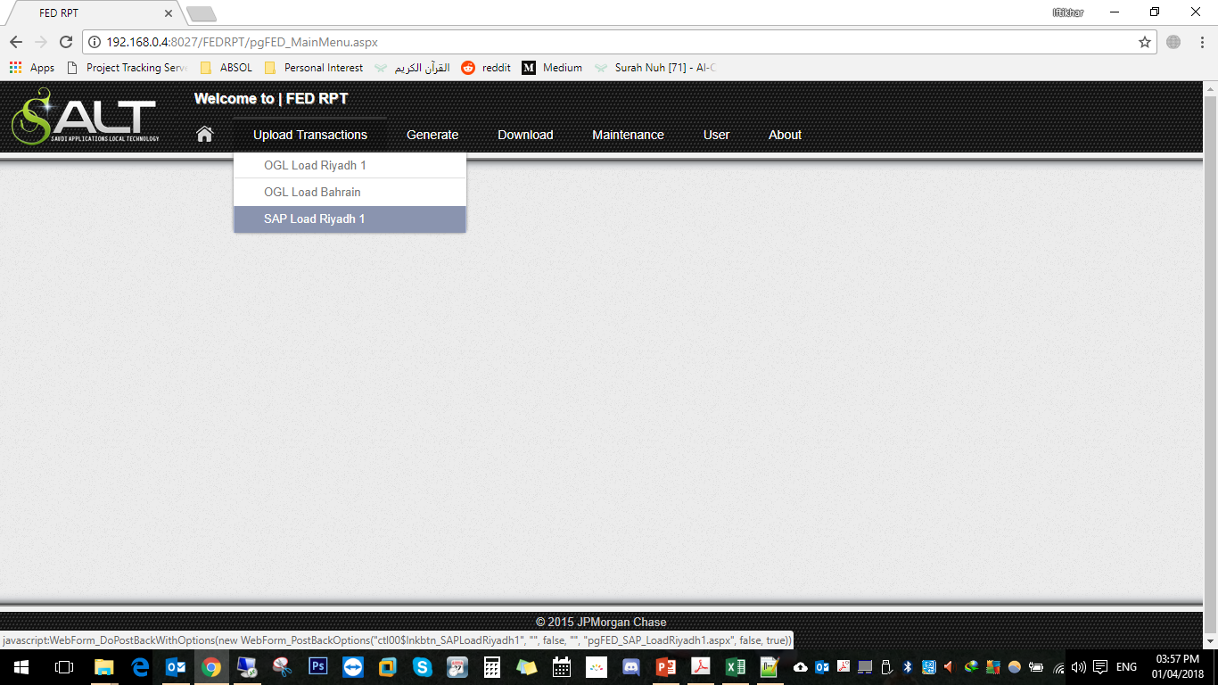
Steps
Select office location
Upload OGL or SAP raw data
Make jurisdiction Mappings
Generate SFF Tab 3 and 4 standard files
Download generated files to view

Slide 4
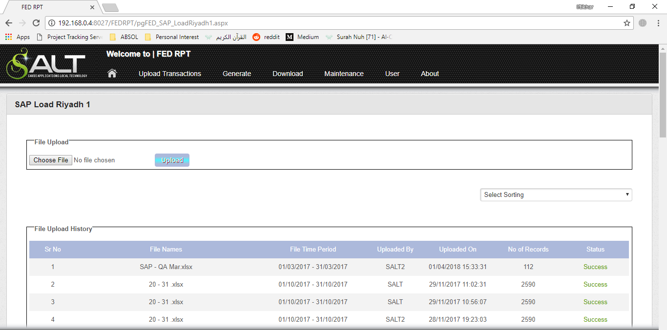
Steps
Select office location
Upload OGL or SAP raw data
Make jurisdiction Mappings
Generate SFF Tab 3 and 4 standard files
Download generated files to view

Slide 5
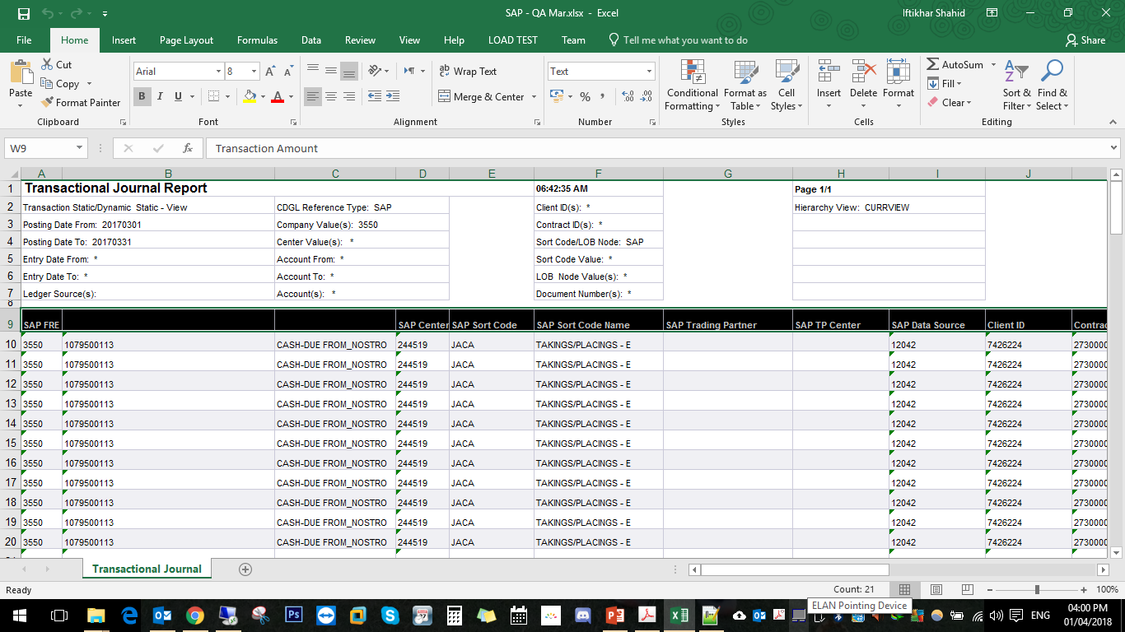
SAP File Format
SAP File Columns
SAP FRE
SAP Center
SAP Sort Code
SAP Sort Code Name
SAP Trading Partner
SAP TP Center
SAP Data Source
Client ID
Contract ID
Document Type
Line Item Number
Line Item Text
Debit/Credit Ind
Ledger Source
Posting Date
Entry Date
Entry Time
Entered By SAP ID
Document Number
Transaction CCY Code
Transaction Amount

Slide 6
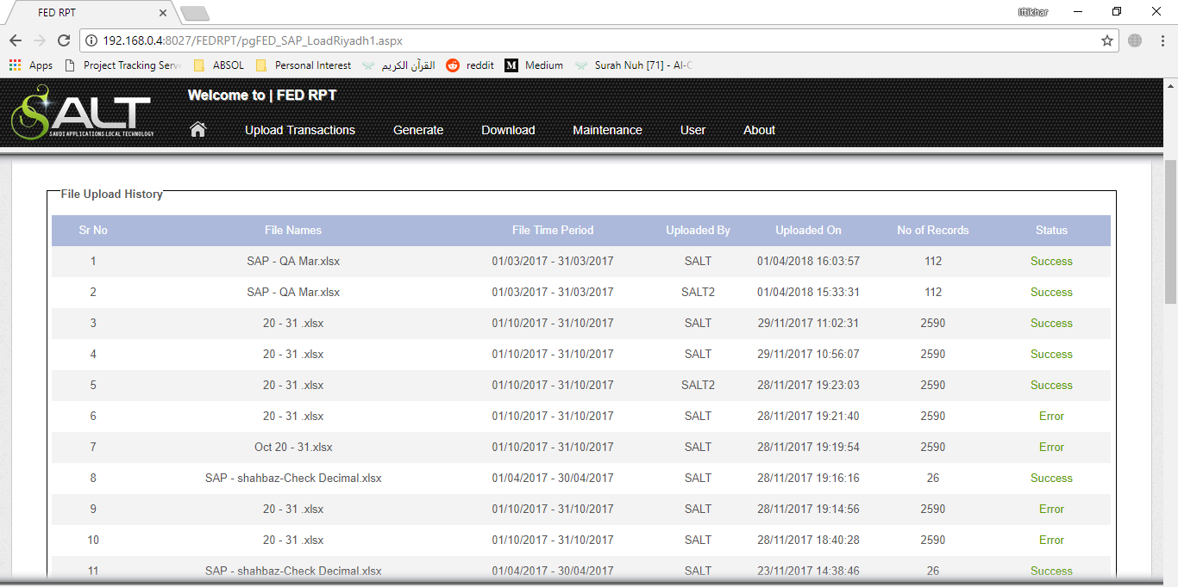
View the status of uploaded files

Slide 7
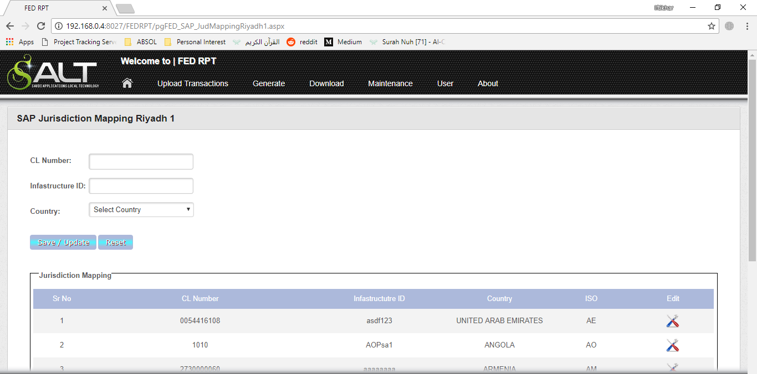
Steps
Select office location
Upload OGL or SAP raw data
Make jurisdiction Mappings
Generate SFF Tab 3 and 4 standard files
Download generated files to view
Select a client number, infrastructure id
and country

Slide 8
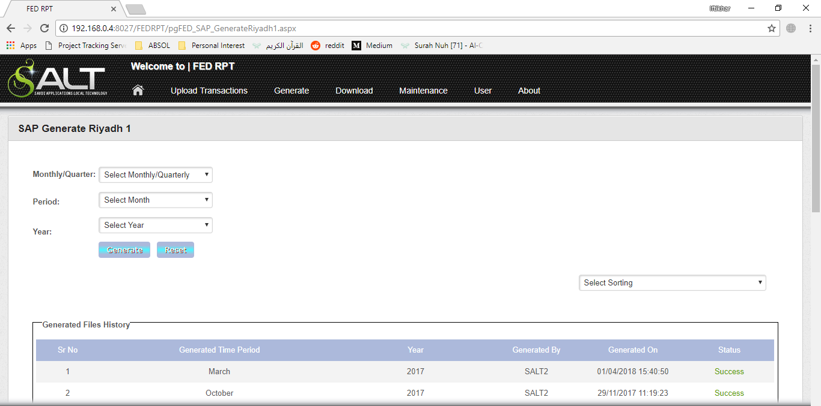
Steps
Select office location
Upload OGL or SAP raw data
Make jurisdiction Mappings
Generate SFF Tab 3 and 4 standard files
Download generated files to view
Select report frequency (monthly/quarterly),
Period and year to generate report.

Slide 9
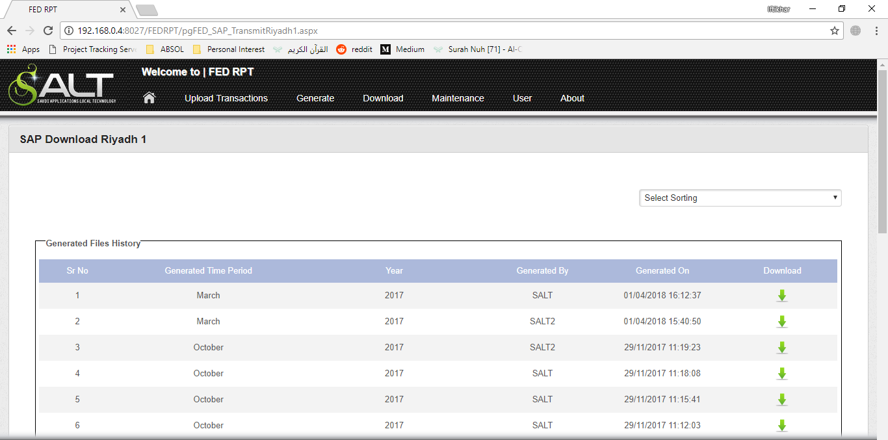
Steps
Select office location
Upload OGL or SAP raw data
Make jurisdiction Mappings
Generate SFF Tab 3 and 4 standard files
Download generated files to view

Slide 10
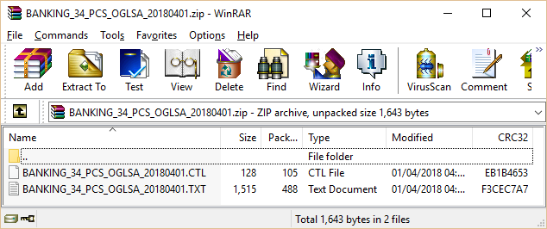
Steps
Columns of the generated SFF TAB File
Source ID
Date
Infrastructure ID / Trans Type
Agent Role
Product
Infrastructure Currency
Client Currency
Jurisdiction
Activity Type
Business
Legal Entity Nostro
Primary Legal Entity / ECI
Processing LE / ECI
Pay Volume
Pay Value (USD Equiv)
Receive Volume
Receive Value (USD Equiv)
Pay Value Infrastructure CCY
Receive Value Infrastructure CCY
Pay Value Client CCY
Receive Value Client CCY
Select office location
Upload OGL or SAP raw data
Make jurisdiction Mappings
Generate SFF Tab 3 and 4 standard files
Download generated files to view
.ZIP file is downloaded that includes
.CTL format and .TXT format

